Slide 1
Problem Solving
Original slide from SE1PR11 -2015 : University of Reading

Slide 2
Problem Solving
“Programming” is a process of Problem Solving
Computers can only perform one simple step at a time (arithmetic operations).
As of September 2017, the most powerful computer has a peak performance of
93 PFlop/s (P=10¹⁵): ninety-three Millions of Billions floating point operations per second.
93 * 10⁶ * 10⁹
How can we make a computer to solve a complex "Human" problem?
Computers use Algorithms to solve problems, and change data into useful information.

Slide 3
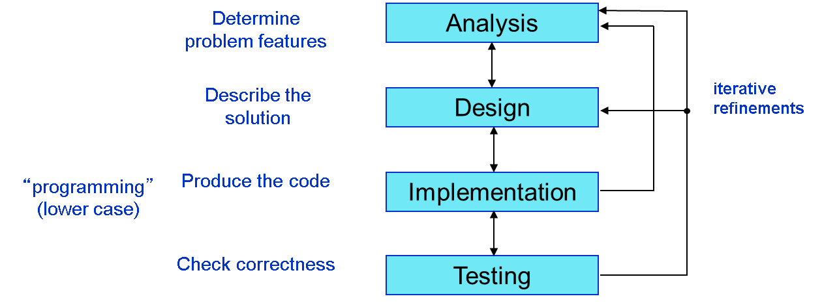
Problem Solving

Slide 4
Programming as Problem Solving
The purpose of writing a program is to solve a problem
The general steps in problem solving are:
Understand the problem
Dissect the problem into manageable pieces
Design a solution
Analyze the complexity of the algorithm
Consider alternatives to the solution and refine it
Implement the solution
Test the solution and fix any problems that exist

Slide 5
Programming as Problem Solving
Many software projects fail because the developer didn't really understand the problem to be solved.
We must avoid assumptions and clarify ambiguities.
As problems and their solutions become larger, we must organize our development into manageable pieces.
This technique is fundamental to software development.

Slide 6
Design
Often the problem is not well defined
we need to analysed it and to outline the requirements
Design a plan (algorithm) to solve the problem
We need to describe the solution (explain what/why/how to do)‏
We need to produce a complete, clear and readable description of the problem and its proposed solution.
Adds value to the proposed solution (readability)‏
Reduces the risk of errors in the plan (logic error)‏
Good Problem Solving skills are based on knowledge, logic and experience

Slide 7
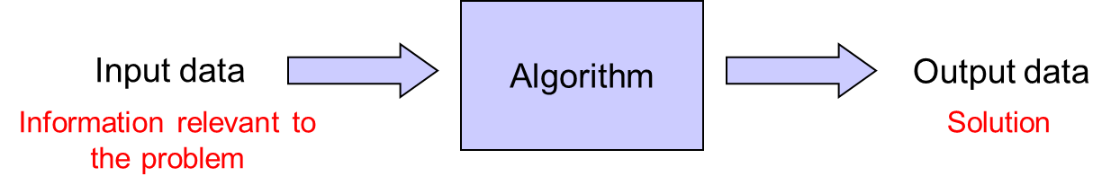
Algorithm
Informally: “An algorithm is a set of steps that define how a task is performed.”
Formally: “An algorithm is an ordered set of unambiguous executable steps, defining a terminating process.”
Ordered set of steps: structure
Executable steps: doable
Unambiguous steps: follow the directions
Terminating: must have an end

Slide 8
Examples
How to open a door
How to make a cake
Given two integer values, identify the greater one.
Find all prime numbers in the interval [1, max], where max is a maximum given value.
Find all prime numbers in the interval [1, max], where max is a maximum value decided by the user.
Make a mobile robot to reach a target destination and to avoid obstacles in the path.

Slide 9
Properties of an Algorithm
Correct
Always returns the desired output for all legal instances of the problem.
Efficient
Can be measured in terms of resources
Running time (time complexity)‏
Memory requirement (space complexity)‏
Bandwidth (communication speed)‏
Unambiguous, precise
Stays the same independent of
which kind of hardware it will execute it
which programming language it will be written in
solves a well-specified problem in a general way

Slide 10
From the Plan to a Running Program
Algorithm
Design an
Write the
Program (Source Code)
Compile the
Program (Executable)
Run the
Process

Slide 11
How to Describe an Algorithm
We must describe the algorithm if we expect our solution to be understood by others.
We also need it to verify the correctness of the approach, to make coherent changes if needed.
How:
NATURAL LANGUAGE
PSEUDOCODE
FLOWCHARTS
(PROGRAMMING LANGUAGE)‏

Slide 12
Pseudocode
“Pseudo” means “pretend” or “false”
Pseudocode is pretend or false computer code; generic English-like terms that are somewhat like computer code
“somewhat like” because it uses the basic constructs of (structured) programming languages.
Pseudocode syntax is not standardized
It is a semi-formal representation of an algorithm

Slide 13
Real World Pseudocode Example
Pseudocode: How to Start a Car
1. 2. 3. 4. 5. 6. 7. 8. 9. 10. 11. 12. 13. 14. | Insert Key in Ignition Turn Key to Start Position Repeat While Engine Hasn’t Started Hold Key In Start Position If 6 Seconds have Passed then Turn Key to Off Position Wait 10 Seconds Turn Key to On Position End If End While

Slide 14
Flowcharts
Flowcharts are an alternative or complementary way to Pseudocode to represent algorithms.
A Flowchart is a visual representation of an algorithm
A Flowchart uses easy-to-understand symbols to represent an algorithm
Flowcharts have a well-defined standard syntax
Visual elements represent the basic constructs of (structured) programming languages

Slide 15
Flowchart Symbols
Process
Input/Output
Terminator
Decision
Connector
Control Flow

Slide 16
Flowchart Examples: Start a Car
Start
Has Engine Started?
Insert Key
No
Hold Key in Start Position
Turn Key to Start Position
Yes
Has 6 Seconds Passed?
Yes
No
Turn Key to Stop Position
Wait 10 Seconds
Turn Key to Start Position
End

Slide 17
Problem Solving Techniques
Some strategies:
Ask questions
Look for similar problems that are familiar
Means-Ends analysis
Divide and Conquer

Slide 18
Strategies: Ask Questions
When you are given a problem, you ask questions (What, Why, When, and Where?)
In the context of programming
What do I have to work with (What is my data)?
What do the data items look like?
How much data is there?
How will I know when I have processed all the data?
What should my output look like?
How many times is the process going to be repeated?
What special error conditions might come up?

Slide 19
Strategies: Look for Familiar Things
Never reinvent the wheel
If a solution exists… USE IT
Finding the daily high and low temperatures
is really the same problem as
Finding the highest and lowest grades on a test
Both problems can be abstracted as being
Find largest and smallest values in a set of numbers

Slide 20
Strategies: Means-Ends Analysis
Beginning state and End state are often given
You need to define a set of actions that can be used to get from one to the other
Once you have a set of actions, you need to work out the details
Translated to computer programming
Begin by writing down what the input is? (Beginning state)
What the output should be? (End state)
What actions can be performed to obtain results from input data?

Slide 21
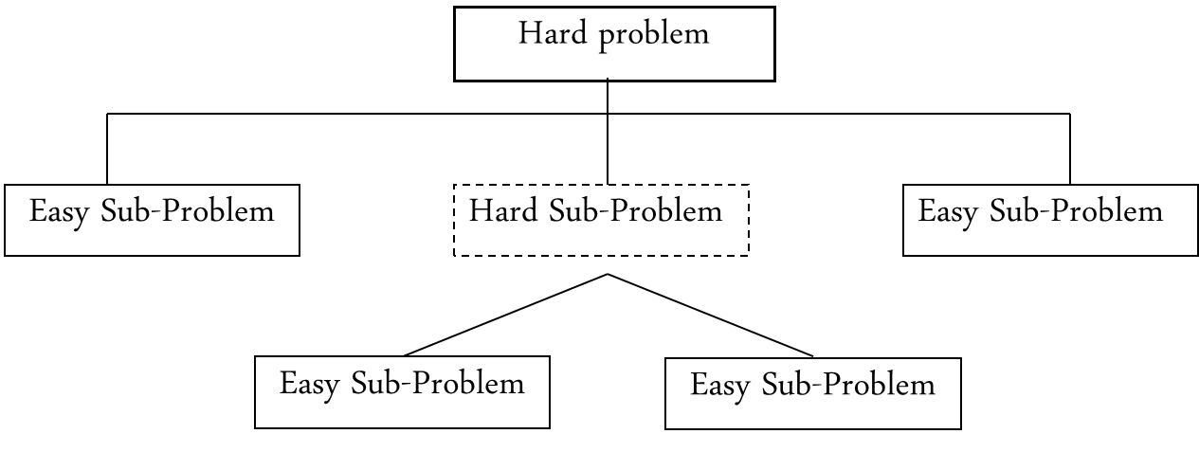
Strategies: Divide and Conquer
Break up large problems into smaller problems that are easier to handle
(Top-Down approach)

Slide 22
Area of Circle Example
Compute the area of a circle
Problem statement
We need an interactive program (user will input data) that computes the area of a circle. Given the circle radius, the circle area should be displayed on the screen.
Input/Output description
Input → Circle radius
Output → Circle area
Algorithm development (set of steps, decomposition outline)
Read value of circle radius (r)
Compute circle area as pi* r²
Print the value of circle area
A=pi*r²
radius r
area A

Slide 23
Area of Circle Example
A divide and conquer block diagram of our problem
Circle Area
Read Radius
Compute Area
Print Circle Area

Slide 24
Area of Circle Example
Pseudocode
1. Prompt the user for the circle radius (write a message on the screen)
2. Read the “radius” value
3. If the value is not valid (e.g. negative number) write an error message and exit with error.
4. Assign circle “area” the value pi * radius²
5. Write the value of the circle “area” on the screen

Slide 25
Area of Circle Flowchart Example
Start
Ask User for Circle Radius
Calculate Area = pi * radius²
Read User Input
Print Area to Screen
Is Input Valid?
Yes
No
Print Error Message
End

Slide 26
The Three Programming Constructs
Any problem, regardless of how complex, can be broken down into three basic constructs
SEQUENCE
SELECTION (Conditionals, If)
ITERATION (Looping)

Slide 27
Sequence
Sequence is the most basic of the constructs. It is simply performing one step after another.
Each step is followed in a specific sequence, hence the name
Sequence can be thought of as “do this, then do this, then do this”

Slide 28
Sequence
We can implicitly use lines of text to imply the “sequence”. Or even better, we can explicitly use numbering.
Example:
Open the fridge
Take the milk
Drink the milk
Any different order wouldn’t work.

Slide 29
Example
Flowchart:
Start
Pseudocode:
read user
input
1. 2. 3. 4. | Read User Input Do Something Do Something Else Show Result on Screen
do something
do something
else
show result
on screen
End

Slide 30
Selection
Selection is the decision-making construct
It is used to make yes/no or true/false decisions logically
Selection is also called “conditional statement” in programming languages.
Example
if something is true then take this action, otherwise take that action

Slide 31
Example
Flowchart:
Pseudocode:
Start
read user
input
1. 2. 3. 4. 5. 6. 7. 8. 9. | Read User Input If the test is satisfied (True) Do Something Else (the test is not satisfied (False)) Do Something Else End If Show Result on Screen
test
F
T
do something
do something
else
show result
on screen
End

Slide 32
Iteration
Iteration comes from the word “reiterate”, which means to repeat
Iteration is a looping construct
Iteration is a combination of decision and sequence and can repeat steps
Implicit number of iterations
Iteration can be thought of as “while something is true, keep doing this, otherwise stop”
Explicit number of iterations
repeat this 5 times

Slide 33
Example
Flowchart:
Start
Pseudocode:
1. 2. 3. 4. 5. 6. 7. 8. | Read User Input While test is true Do Something End While Do Something Else Show Result on Screen
read user
input
test
F
T
do something
do something
else
show result
on screen
End

Slide 34
Range Algorithm Example
Flowchart: Range (Assume Max Number is 999)
Start
Get Next Number
Set Max to 0
Are there
Numbers
Left?
Yes
Is
Next Number
Larger Than
Max?
Set Min to 999
Yes
Set Max to Next Number
No
Get Sequence
of Numbers
No
Is
Next Number
Smaller Than
Min?
Yes
Set Min to Next Number
End
No

Slide 35
Range Algorithm Example
Pseudocode: Range (Assume Max Number is 999)
1. 2. 3. 4. 5. 6. 7. 8. 9. 10. 11. 12. 13. 14. 15. 16. 17. 18. 19. 20. | Set Max to 0 Set Min to 999 Get Sequence of Numbers While there are numbers left in the sequence Go to next number in sequence (first number if first time) If number is greater than Max Set Max to current number End If If the number is smaller than Min Set Min to Current Number End If End While Set Range Equal to Max – Min Output Range

Slide 36
Problem Solving Practice
Not necessary to programming code
For example
https://www.bebras.org/
http://www.bebraschallenge.org/index.php
https://csunplugged.org/en/

